Slide 1
Presenting Yourself on the UC Application for Undergraduate Admission – Transfers
August 2016
Notes:
Thank you for taking time to learn about the UC admission application and review helpful tips so that applicants can best present themselves.
This presentation is for students who are applying as transfers applicants.

Slide 2
Overview
Before You Begin
How Applications are Reviewed
Completing the Application
The personal insight questions
Submitting the Application
2
Notes:
This presentation covers the topics indicated above.

Slide 3

Before You Begin
Notes:
Before you begin, it is important to understand the application process and what can be done to prepare to complete the application.

Slide 4
Application Timeline
Transfer
Date/Deadline | Task
August 1 | UC Application Opens
November 1-30 | Submit UC Application Online
Late January | Update Fall Term Grades and Course Schedule
March - April | Notification of Admission
June 1 | Statement of Intent to Register (SIR) Deadline
Mid-June to July | Waitlist Admission Notification
D
E
C
B
4
Notes:
Transfer applicants can access the application beginning August 1.
Applications can only be submitted between November 1 and 30. It is very important to meet the deadline. Late applications are rarely accepted.
In early January, applicants will receive an email message instructing them to log into their My UC Application to submit their fall term grades and update UC on classes they will complete during the winter, spring and summer terms. Failure to submit the Transfer Academic Update form by January 31 may lessen chances for an admission offer.
In early to mid-January, each campus the student applied to will email them to create a login username and password for access to the campus’ applicant portal. This is the site at which the admission decision will be posted along with other important information—check each campus’ applicant portal frequently. Be sure to safeguard your passwords.
Campuses may begin to admit students as early as March 1, but most students will receive notification of admission via the campus’ applicant portal during the months of March through the end of April.
Some students may receive an offer to be placed on a waitlist at one or more campuses. If applicants receive such a message they must be sure to respond by the stated deadline. UC campuses very rarely make exceptions for a late response.
June 1 is the deadline to submit the Statement of Intent to Register (SIR) (accept an offer of admission) to ONLY ONE UC campus for all transfer admits who received an offer by May 1. Admit offers received after May 1 will include a corresponding SIR deadline.
In mid-June to July, campuses will notify applicants who accepted a place on the waitlist of the final decision on their application.

Slide 5
Student Preparation
Research Campuses Early
Gather Materials
Brainstorm
Apply Broadly
Ask for Advice and Feedback
Email Communication is Critical
5
Notes:
For students, we recommend the following:
Begin preparing for the application now – don’t wait until November
Start by researching the campuses so you know where you want to apply, and for what major. It’s a good idea to review the curriculum of your intended major in the General Catalog for each campus; the courses required/offered for the same/similarly named major might be different from one campus to another; review the course descriptions and ask yourself “Is this a course I would want to take?”. Learn about the courses you will be required to take in order to earn the UC degree so you are fully informed about UC graduation requirements to plan how long it will take to graduate. At most campuses junior transfer students can graduate in two years plus one additional term, if they plan carefully.
Check for available majors at: admission.universityofcalifornia.edu/how-to-apply/check-majors/index.html. Not all majors are open to transfer applicants, or for every term.
In addition, remember that for most campuses, completion of general education requirements (the freshman/sophomore level courses) are not a part of the admission selection process. Therefore, you may want to take some time to investigate if you will be required to complete general education/breadth courses after you transfer to UC – this may extend the time it takes for you to graduate. For California community college students, if the IGETC pattern of general education requirements is accepted by the UC program to which you are admitted, you may only have to complete a few junior/senior level G.E. courses to graduate from UC.
Gather materials that you’ll need: transcripts/academic records, list of current and planned courses, AP/IB test scores, awards and honors, volunteer program timelines and hours, employment timeline and hours, etc.
Brainstorm: take time to remember all the important things you have done throughout the last few years, from club involvement, to volunteering, to athletics and leadership, and more.
UC campuses are selective: Apply to different types of campuses throughout the system for your best chance of being admitted and finding a good match. Information on each UC campus can be found at admission.universityofcalifornia.edu/campuses/index.html
Your short answer responses to the personal insight questions, and the mandatory question, are important! Write it early. There are online resources with writing tips (a video is available as well) and a worksheet to help you get started. And, remember they are personal insight questions and about you. It is not an English essay. Admission staff want to learn about you. What you did and why; what you learned and how you applied what you learned to aspects of your life. Use “I” statements – I did this, I chose to do that, I learned about . . . . It’s your one opportunity to ensure we get to know you.
Campuses use email to communicate with applicants during the application process: students should create an email account (preferably one that identifies them instead of a “cute” or “non-distinct” name) and be sure that they will check it regularly.

Slide 6

How Applications are Reviewed
Notes:
When an applicant completes the UC admission application, it is important that they understand how their application information will be reviewed by the campuses. This section will provide guidance on the importance of the information provided and how campuses will use the information to understand the context of the applicant’s educational experience.

Slide 7
Requirements vs. Selection
Every UC Campus
  • Receives the same application from you
  • Reviews for minimum requirements
  • Reviews for admission individually using content of the application
7
Notes:
Requirements: All UC Campuses have the same minimum requirements for transfer applicants to ensure that all students are prepared to be academically successful at the University. Additional requirements for the intended major and graduation requirements such as general education courses may be required/considered for admission selection. Be sure you are aware of all three categories of requirements: 1. minimum courses; 2. major courses; and 3. general education/graduation requirements. In some cases one course may be used to satisfy more than one requirement.
Selection: Selection is a process at each campus which is necessary when more applicants apply to a program than a campus can admit and enroll. Each UC campus evaluates applicants beyond just their GPA in order to select the applicants who would are best suited to their campus. However, completion of required courses, especially for the major, with strong grades is critical to being a competitive applicant for selection.
Applicant Pool: Who else is in the applicant pool? Applicants must remember that they are not just applying with students from the college/university and community, but also with students from all parts of California, the U.S. and from other countries, whose backgrounds may be similar or different from their own. UC receives applications from students with a variety of attributes: those living in small rural areas, students from families with low and high incomes, communities that have high and low college-going rates, students who are single-parents, U.S. military veterans, students working full-time, nonresident students, etc. Even if a student thinks their background or situation is typical (or not unique) it is important to explain (not complain) why, so UC admission staff understand the applicant better. The admission staff need more than just a school name or city to get a better sense of the applicant.
It is also important to note that each UC campus evaluates the application without knowing the status of the same application at another campus. For example, one campus will not admit or deny due to the admission decision from another campus.

Slide 8
Comprehensive Review
Campuses Look For
• Strong grades & course preparation
• An inclusive educational experience
Assess Student Within Context
• Educational environment
• Available resources and opportunities
The Full Application
Not just the personal insight questions
8
Notes:
First, it’s important to know how we review applications
In general campuses look for:
Strong grades & major preparation.
Involvement, leadership – “Well-rounded” doesn’t mean a student has to do everything, but we like to see evidence of students being involved outside of the classroom in activities they are passionate about – an inclusive educational experience.
Evidence of hard work – Campuses want to know if an applicant can be a successful university student.
UC looks for students who have challenged themselves in many ways: students are most successful at our campuses if they have shown academic promise through their courses/grades, major preparation and other academic pursuits.
Each applicant is reviewed within the context of his or her available opportunities: If a student does well compared to peers within the same situation (school, environment, etc.) and uses the application to explain that context, the applicant will provide UC readers with a better understanding of how they were able to achieve/complete what is presented on the application.
We ask many questions as part of the application process so that we can get to know each student. Our goal is get a sense of the applicant’s life, interests and personality through their application, in addition to reviewing coursework and grades earned.
Applicants would do themselves a disservice if they do not thoroughly, accurately, and completely fill out all parts of the application.

Slide 9
Comprehensive Review
Grade Point Average in all transferrable courses
Completion of courses to meet major preparation
Completion of courses to meet breadth requirements
Participation in academic honors courses or programs
Completion of an associate degree for transfer offered by a California community college
Special Talents, Achievements, and Awards
Completion of Special Projects
Academic Accomplishment Within Life Experiences
Geographic Location
9
Notes:
Each UC campus has a unique application review process developed by its faculty committee. Each campus may place a different emphasis or value on the information in the application in the Comprehensive Review process.
What is comprehensive review?
Process each campus uses to consider applicants.
ALL campuses conduct a Comprehensive Review.
The faculty at each campus can determine how to implement Comprehensive Review on their campus.
Meeting minimum requirements/qualifications does not guarantee admission to a specific campus.
Comprehensive Review:
UC evaluates applicants based upon more than GPA. Each applicant’s academic achievements are considered in light of the opportunities and resources available to them as well as their potential to contribute to a campus.
Each campus may differ on the relative weight (if any) accorded to any criterion.
Students should visit each campus’ website for the specific selection process.
Comprehensive Review Factors:
UC faculty have established 9 factors that can be considered for Transfer applicants; these factors are not listed in any priority order:
Completion of a specified pattern or number of courses that meet breadth or general education requirements.
Completion of a specified pattern or number of courses that provide continuity with upper division courses in the major.
Grade point average in all transferable courses, and, in particular, grade point average in lower division courses required for the applicant's intended major.
Participation in academically selective honors courses or programs.
Completion of the California community college associates art degree for transfer (referred to as the ADT, AA-T, or AS-T).
Special talents, achievements, and awards in a particular field, such as in the visual and performing arts, in communication, or in athletic endeavors; special skills, such as demonstrated written and oral proficiency in other languages; special interests, such as intensive study and exploration of other cultures; or experiences that demonstrate unusual promise for leadership, such as significant community service or significant participation in student government; or other significant experiences or achievements that demonstrate the applicant's promise for contributing to the intellectual vitality of a campus.
Completion of special projects undertaken either in the context of the high school curriculum or in conjunction with special school events, projects or programs co-sponsored by the school, community organizations, postsecondary educational institutions, other agencies, or private firms, that offer significant evidence of an applicant's special effort and determination or that may indicate special suitability to an academic program on a specific campus.
Academic accomplishments in light of the applicant's life experiences and special circumstances. These experiences and circumstances may include, but are not limited to, disabilities, low family income, first generation to attend college, need to work, disadvantaged social or educational environment, difficult personal and family situations or circumstances, refugee status, or veteran status.
Location of the applicant's secondary school and residence. These factors shall be considered in order to provide for geographic diversity in the student population and also to account for the wide variety of educational environments existing in California.
Note: The UC Transfer Pathway is an example of a pattern of courses that provide continuity with upper division courses in the major. The UC Transfer Pathway applies to numbers 2, 3, and 5 of the nine comprehensive review factors that are considered for transfer students.

Slide 10

Completing the UC Application
Notes:
To complete the UC online admission application, go to: https://universityofcalifornia.edu/apply

Slide 11
Importance of Accurate Details
Statement of Application Integrity
Academic History
AP/IP Examination Scores
Activities Outside of School
Verification of Application Information
11
Notes:
It is very important for students to thoroughly complete all sections of the application and to do so accurately. This is the opportunity to tell the admission staff about personal details that make each applicant unique.
Begin by reading the Statement of Application Integrity. Click on the link on the log-in page of the application, or go to: admissions.universityofcalifornia.edu/docs/StatementOfIntegrity.pdf
Accurate Details:
Academic History: MUST be accurately reported--all enrollment, every school/college, all courses and grades (even if a course was repeated, received academic renewal (AR), earned a grade of “Withdraw” (W) or “Not Passed/No Credit” (NP/NC) even if the applicant doesn’t think the course work is transferable, or older grades that are not reflective of current academic ability, etc.).
If a student accepts an offer of admission, UC requires official academic records to verify the information reported.
“Additional Comments” box in the Academic History section can be used to provide detailed information or explanations about specific academic issues – declining grades, class availability issues, etc.
Examination scores: report results for AP/IB exams already completed.
Activities/Awards: Use the Worksheet in the Quick-start Guide for Applying to UC:
Transfer [PDF] admission.universityofcalifornia.edu/counselors/files/apply-online-transfer.pdf
Don’t abbreviate the names of clubs or awards: Spell them out and explain your level of involvement.
Don’t list the same activity in multiple areas (for instance listing Honors Society in “Awards and Honors” and “Extracurricular Activities”), but make sure the most important activities are reflected in some way.
If the applicant, for example, takes care of siblings or in other ways support their family which does not allow them to take part in as many activities outside the classroom, let UC admission staff know in the response to the personal insight questions. We understand that students are gaining valuable life experience and consider that as part of our comprehensive review.
UC does verify information that students report on the application. It is critical that students do not misrepresent or falsify information, as this is a serious offense and will result in serious consequences. Honesty is the best policy.

Slide 12
The Basics
Contact Information
So campuses can contact you
Campus/Major Selection
Apply broadly
Fee Waiver
30-Minute Time Out
“Next” or “Log-out” to save
12
Notes:
Students must carefully complete the entire application:
Contact information --- including an email address which UC will use to communicate with the applicant (preferably one that identifies them instead of a “cute” or “non-distinct” name) and be sure that they will check it regularly.
Students can also provide a phone number where they can receive text messages from the campuses
Family background information is optional but may be helpful for UC to understand the context of resources and opportunities available to the student
Campus selection: Make decisions wisely, apply broadly. Information on each UC campus can be found at: admission.universityofcalifornia.edu/campuses/index.html.
Major selection: Transfer students must select a major. Major selection should be in conjunction with the coursework that the students has or will complete. Telling us about how the interest developed (courses, activities, volunteer work and/or employment related to the major) is very helpful. Any insight provided helps UC admissions staff to better understand choices the student has made and helps provide context for the student’s achievements or extracurricular activities.
A fee waiver to apply to up to four campuses free of charge is available online at the end of the application during the submission process for applicants who meet the qualification criteria. More information is available on slide 40.
The application will automatically save information when “next” or “log-out” is clicked, but not when the browser is closed without clicking next or log-out; there is a 30-minute inactivity period after which the application system will automatically log-out.

Slide 13
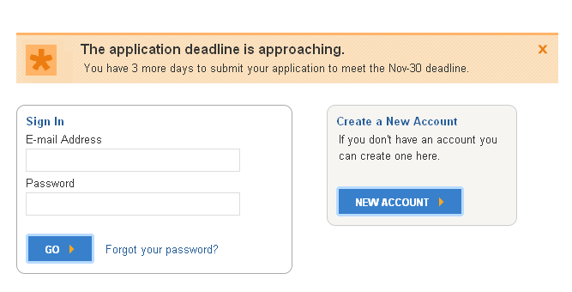
Getting Started
First time users start here!
Application Deadline: November 30, 11:59 p.m. PST
Apply Online at universityofcalifornia.edu/apply
13
Notes:
Create Your Account
New users must enter a unique e-mail address and password
Applicants will use this same account if they apply again in the future
If the students’ family has multiple applicants or has future applicants, different e-mail addresses must be used for each applicant
Passwords must be at least eight characters (and must have a combination of uppercase and lowercase letters, numbers and/or symbols)
Create a secret question/answer combination that will be easily remembered
Be sure to keep login information safe
Once “Create a New Account” is complete, an e-mail confirming the start of your application will be sent
Campuses use e-mail to send critical, time-sensitive correspondence to applicants, so provide an e-mail address that is checked regularly and will be kept until enrolling in college
Remember to adjust e-mail filters to accept mail from UC addresses
Review
Statement of Integrity before starting the application
Common questions on each page
Open/closed majors
Downloadable “Apply Online to UC” brochure
Log In
First-time users start by clicking “New Account”
On return visits, enter e-mail and password information under “Sign In”

Slide 14

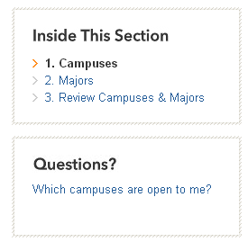

Navigating
Use the progress bar above to navigate
Use sections on the right for guidance
Use buttons below to move from page to page
Note ‘my uc application’, ‘help’, and ‘sign out’
14
Notes:
Navigating the Application
The highlighted step on the progress bar shows the current section of the application the student is working on
Each page has an “Inside This Section” and “Questions” area
Use the “Next” and “Previous” buttons on the bottom of the page to save and move through the application. Don’t use the browser navigation (i.e. Internet Explorer, Firefox, Safari, Chrome).
After the first step has been completed, “Start Application,” click on any of the top navigation boxes or steps in “Inside This Section” to move to the next step or jump ahead.
Navigating to another page will save your work
If account information (e-mail, name, date of birth), needs to be changed/corrected this can be done this in “My UC application” section at the top.
“Sign Out” stores the information entered

Slide 15
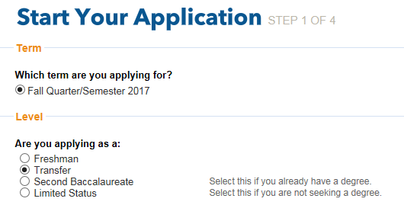
Starting Your Application
15
Notes:
Term: Select the term for which you are applying for admission to UC. Note: most campuses and majors are open for the fall term only. It is important to review which programs will be available during the term in which you intend to apply.
Level: Be sure to select the appropriate level for which you are applying. You are a transfer student if you enrolled in a regular session at a college or university after high school (does not include summer terms).

Slide 16
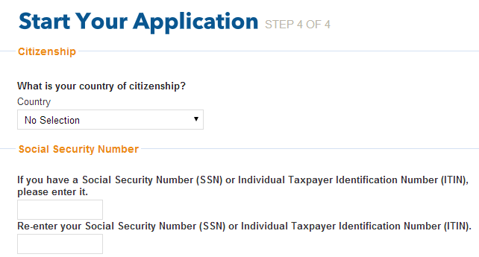
Starting Your Application
All students must enter a social security number if they have one
16
Notes:
Citizenship
You must select a country of citizenship or “No Selection” in the country drop-down.
Applicants who choose a country other than the United States will have follow-up questions on permanent residency and/or visa status (students who choose “No Selection” will not have follow-up questions).
Undocumented Students
For country of citizenship, select “No Selection” and do not enter a social security number.
Social Security Number (SSN)
All applicants who have a social security number (SSN) are required to enter it here.
Deferred Action for Childhood Arrivals (DACA)
Enter a valid SSN, SSN for work purposes, or ITIN if available. Otherwise, leave it blank.
If an applicant does not have a SSN, he/she may skip that item.
We use the SSN to accurately and reliably merge test scores and the federal financial aid application with the admission application.
SSN, SSN for work purposes and ITIN numbers are encrypted and kept secure.

Slide 17
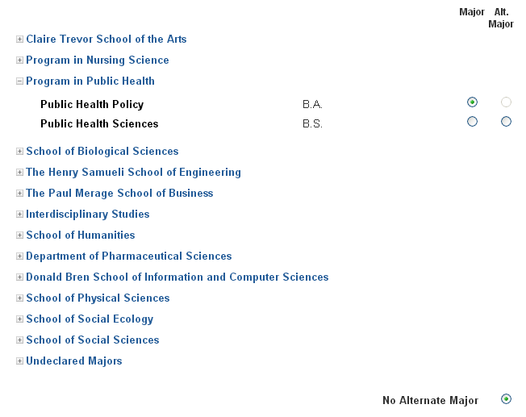
Selecting a Major
Click to expand the list of majors
17
Notes:
Choosing a Major
Students must select a major for each campus to which they are applying. Undeclared/Undecided is generally not an option for junior transfers.
The online application displays which majors are open/closed to that particular applicant level.
Hovering over certain colleges/majors may cause additional information to appear.
Select an alternate major if available (alternate majors are not available at Berkeley or Santa Cruz), or select “No Alternate Major” at bottom of the list if the applicant chooses not to select one.
If a campus is unable to offer you a place in your first-choice major, they may consider you for an alternate major—be sure the alternate major is in a subject area that you really want to study.
After selecting major/alternate major, scroll to bottom of the page and click “Next”.
Repeat steps for each campus selected.
If most of the majors are closed, it may be that the student has selected the incorrect applicant level or the open filing period has ended.

Slide 18
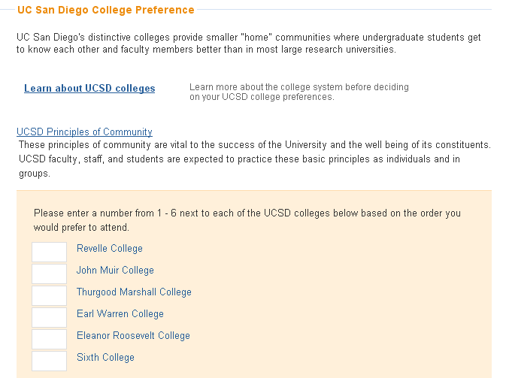
Ranking San Diego Colleges
You must click here before ranking the colleges
18
Notes:
San Diego Colleges
If a student is applying to UC San Diego, they must rank the colleges in order of preference to have the best chance of assignment to the college of their choice
The order of ranking of colleges does not affect the chances for admission to UC San Diego
Boxes to rank the colleges only appear once the student clicks the “Learn about UCSD colleges” link (opens a pop up window). Students should be sure to carefully read the information provided to understand the “theme” of each college at UC San Diego

Slide 19
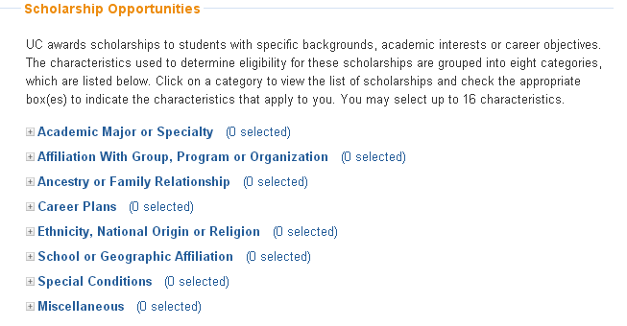
Scholarships
Review and select up to 16 scholarships that match your characteristics, interests, and background!
19
Notes:
Scholarship Opportunities
“Restricted” scholarships are available to students with backgrounds or career goals that meet the criteria of the scholarship. There are about 230 scholarships, with a dozen new scholarships this year. To be considered for these scholarships, students need to:
Open each scholarship category to see the expanded list
Review each scholarship and select if a characteristic applies to them
Select up to 16 choices
Scroll to bottom and click “Next” to save the selections
Research other campus-based scholarships in the link provided

Slide 20
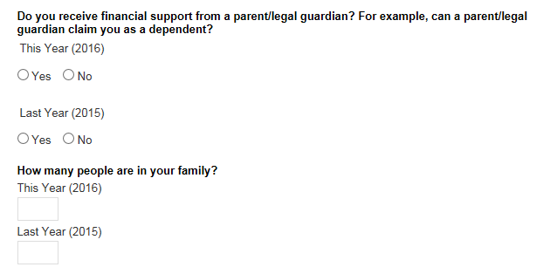
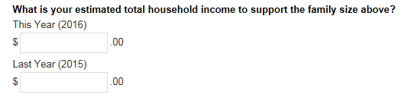
Biographical Information
20
Notes:
Family Size and Income
Information about a student’s income, family size, and parents/guardian’s education and income, is used to provide contextual information about the home environment and for the application fee waiver.
Students can correct income information before the application is submitted (not after), but cannot resubmit for fee waiver based on revised information.
This information will not be used to determine residency status or financial aid.
Additional Circumstances
More information for foster youth is available on the UC Counselor’s website.
Applicants interested in the Educational Opportunity Program (EOP) which provides support services while a student is enrolled at UC, will need to provide a brief statement, as well as parent education and income information. To be clear, EOP is not an admission process. If you are offered and accept an offer of admission, you may received information from the campus’ EOP office. Unlike the CSU system, at UC there is no separate admission process for students who are interested in EOP.

Slide 21
Academic History for
Transfer Applicants
Notes:
It is important that students have all transcripts (academic records) from all schools they have attended since the end of high school. The courses/grades entered must exactly match the official academic record.
[Note: For freshman/sophomore transfers, in the few situations in which a campus may accept such applications, you must also have your high school academic records available.]
To begin this section, the applicant must have their records in front of them.

Slide 22
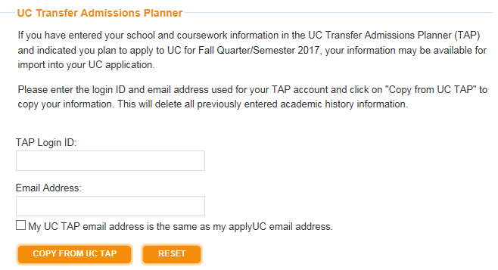
UC Transfer Admission Planner
Students using UC TAP can import information from TAP to the UC application
22
Notes:
For applicants who have entered their academic information into the UC Transfer Admission Planner, we have a feature in the application where the coursework is complete and accurate and can be imported into the application for admission. The information is updated daily each morning with the previous day's data. Changes made today in UC TAP will not be reflected in the data imported on the same day.
In order to import the coursework, applicants must use their UC TAP ID and email address from the UC TAP account.

Slide 23

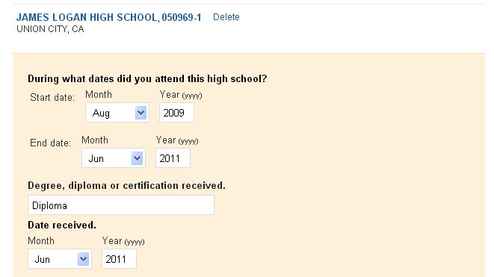
High School Attendance
23
Notes:
Transfer applicants must provide the dates of attendance for the last high school attended and diploma or certificate information, if applicable. Once this information is added, all the school information will appear in a table for review and editing.

Slide 24
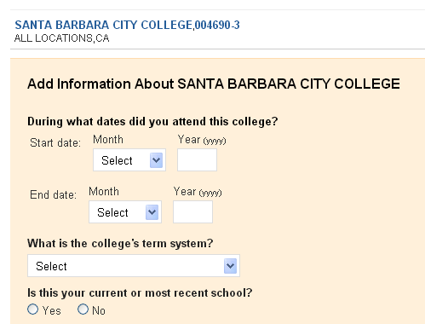
College Attendance
Provide basic information about your college
24
Notes:
Transfer applicants must provide the dates of attendance for all colleges attended, term system, and diploma or certificate information. Once this information is added, all the school information will appear in a table for review and editing.
Dates of attendance should be entered as consecutive dates even if enrollment was interrupted i.e. first month/year of attendance through the last month/year of attendance.
Students earning the Associate for Transfer degree will provide this information here along with the name of the major .

Slide 25
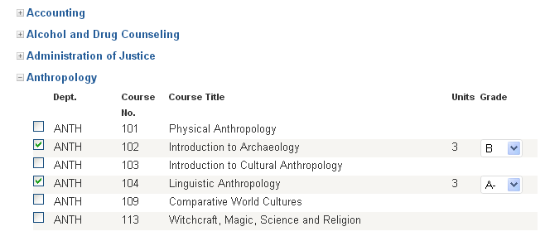

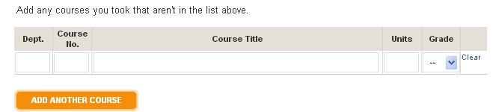
College Coursework
Click to display courses
Enter UC-approved A-G courses taken and grades earned at each school
25
Notes:
For California Community College students:
The transferable course lists for California Community colleges are pulled directly from the ASSIST database - assist.org.
Each department can be expanded to display the courses by clicking on the plus (+).
For non-California Community College students:
UC does not have transferrable course lists for colleges/universities other than California community colleges, so students must to enter coursework manually.
For all students:
Students should enter all courses taken even if they believe they are not transferable, whether or not they want credit for them, whether or not they believe the “old grades” are not reflective of their current academic abilities, they received an Academic Renewal (AR) or Incomplete (I) grade, they withdrew from the course, or they later repeated the course. Missing information may be viewed as falsification and result in cancellation of the application.

Slide 26
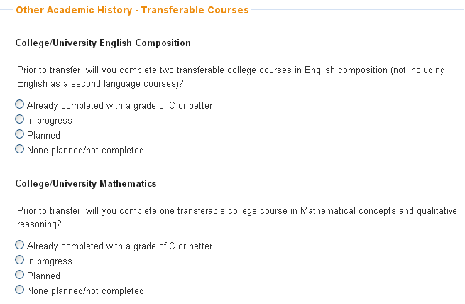
College Coursework
Indicate intent to complete required English and math courses
26
Notes:
If the coursework a student entered indicates that the student has met the minimum English (2 courses) and math (1 course) requirements for transfer to UC, they will not see this screen. However, if student’s coursework appears to be missing a required English or math course, they will need to indicate their plan to complete these courses on this screen.

Slide 27
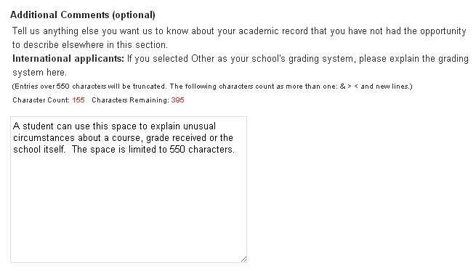
Academic History Comments
Use this space to explain unusual circumstances, not as an extension of the personal insight questions
27
Notes:
Admission staff will look to this section for an explanation of abnormalities in a student’s academic record. For example, a break in attendance, poor grades in a particular course or year, or explaining something specific about the school environment/policies that affect the academic record and/or choices for classes. The additional comments in the academic history section should not be used as an extension of the personal insight questions.

Slide 28
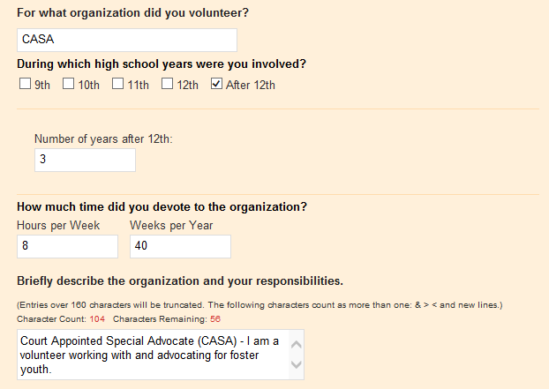

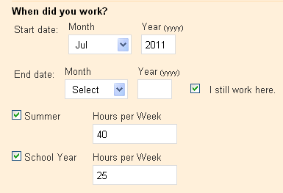
Activities & Awards
Educational Preparation Programs
Community Service
Work Experience
Awards & Honors
Extra Curricular Activities
Choose up to 5 of your most meaningful experiences for each category.
28
Notes:
There are five categories of Activities and Awards, each limited to five entries.
Educational Preparation Programs – such as Puente or MESA. If you don’t see a program listed, enter it manually.
Community Service – consistent participation over time may indicate commitment and dedication.
Work Experience – demonstrates time management, responsibility and perhaps leadership.
Awards & Honors– significant in nature – county-wide, state-wide and national awards indicate a high level of achievement with significant competition. School-based awards are more meaningful to readers if context is provided, such as: X number of X to earn award, but even “perfect attendance” can be insightful.
Extra Curricular Activities – depth and time – continued participation over time.
Enter details about each activity. If an applicant did not have the time/opportunity to participate in school and/or community activities, volunteer/paid employment, it is helpful to application readers to know why – how else did the applicant use their time and explain if it was a choice or a requirement for example: caring for siblings and/or children, elder-care, commitment to doing homework (research projects, papers, etc.), full-time employment, etc.
Applicants should not exaggerate or make things up because the information submitted is subject to verification, and if an applicant is unable to provide proof of the information provided, the application will be cancelled.

Slide 29
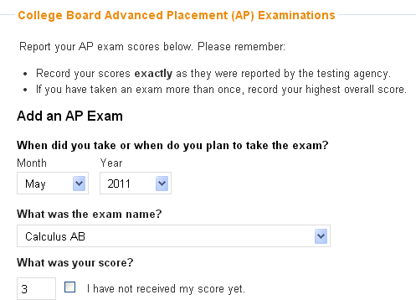
Test Scores
Passing AP & IB exam scores can be used to show subject mastery
29
Notes:
In the Test Score section, students report results of their AP/IB exams if applicable.
We have added a new section for international students to report their national or external examination results as well. Just like AP/IB, if the exam is not applicable to the student, they can click through the section.
Advanced Placement & International Baccalaureate Exams:
Scores can demonstrate academic mastery in individual subjects
Scores must be self reported on the application. No worries about “low” scores, UC treats that as neutral but does acknowledge an attempt was made to earn a score for which UC would award credit toward the UC degree.
TOEFL/IELTS Exams:
For students whose college/university coursework was not conducted in English and if you are not an native English-speaker, you are required to submit TOEFL or IELTS results.
IMPORTANT: Official scores are not required until after a student has accepted an offer of admission; do not send scores at time of application submission.

Slide 30


The personal insight questions
Notes:
The personal insight questions are an integral part of the UC admission application.
They are not reviewed as a stand-alone part of the application.
It is a statement about the applicant, not an essay.
The responses of the personal insight questions should add clarity, richness, and meaning to the information presented in other parts of the UC application, enabling the admissions officer to form the best impression of the applicant.
The personal insight questions must be about and completed by the applicant.

Slide 31
The personal insight questions
Each new question aligns to one or more of the 9 comprehensive review factors for transfer students that campuses consider in their admission decisions.
Transfer applicants must respond to one required question, then choose 3 additional questions out of 7
Maximum of 350 words for each response
All questions have equal value; there is no advantage or disadvantage to choosing certain questions over others
31
Notes:
Transfer applicants will answer one required question in addition to three out of seven additional questions
Each response is limited to a maximum of 350 words.
1,400 words maximum, 400 more than for the previous two prompts.
All questions will have equal value in the admissions selection process. For applicants, there is no advantage or disadvantage to choosing certain questions over others.
The new questions will be included in the fall 2017 application which will be available Aug. 1, 2016.

Slide 32
What are the questions?-Transfer Applicants
Required question:
Please describe how you have prepared for your intended major, including your readiness to succeed in your upper-division courses once you enroll at the university.
Select 3 other questions from the list
32
Notes:
All transfer applicants (sophomores, juniors, seniors) have one mandatory question.
Preparation for the major is critical to the transfer admission selection process.

Slide 33
Then, Select 3 of the following:
1. Describe an example of your leadership experience in which you have positively influenced others, helped resolve disputes, or contributed to group efforts over time.
2. Every person has a creative side, and it can be expressed in many ways: problem solving, original and innovative thinking, and artistically, to name a few. Describe how you express your creative side.
3. What would you say is your greatest talent or skill? How have you developed and demonstrated that talent over time?
4. Describe how you have taken advantage of a significant educational opportunity or worked to overcome an educational barrier you have faced.
5. Describe the most significant challenge you have faced and the steps you have taken to overcome this challenge. How has this challenge affected your academic achievement?
6. What have you done to make your school or your community a better place
7. What is the one thing that you think sets you apart from other candidates applying to the University of California?
33
Notes:
After responding to the mandatory question about major preparation, then Select 3 from the 7 choices
Again, questions align to one or more of the comprehensive review factors
Students should select the questions that are most applicable to them; allowing them to focus on responding to the question.

Slide 34
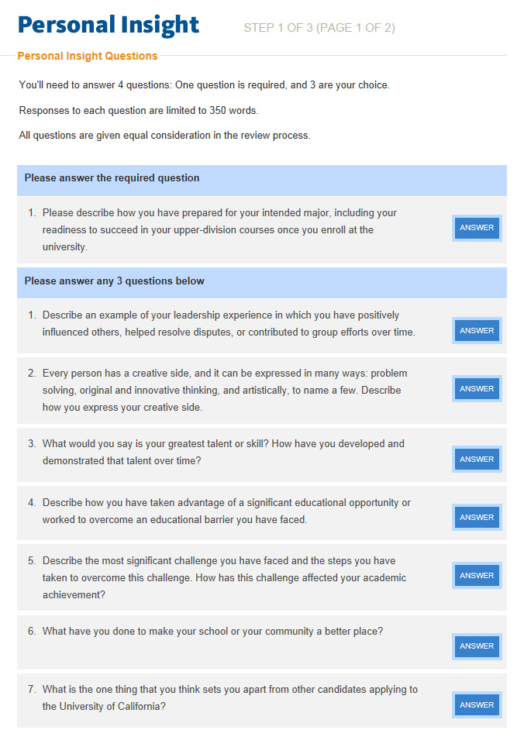
Then, Select 3 of the following:
Click the blue “answer” button to respond to the questions of your choice
34
Notes:
This is view of how the personal insight questions appear in the UC application. Note the mandatory question at the top and the choice of 3 additional question to respond to from the remaining 7.

Slide 35
What does UC expect to learn from the answers?
The new format gives applicants a greater say in the kind of information they want to share
Students can express who they are and what matters to them not only in how they respond to the questions, but also through the questions they choose to answer
Option over which questions to answer gives students greater flexibility and control
Allows students to select questions that are most relevant to them
35
Notes:
Students can express who they are and what matters to them not only in through the questions they choose to answer but also and importantly how they respond to the questions
• By giving students the option to choose questions to answer beyond the required question, they have greater flexibility and control over what personal stories they want to tell us.
Students can select questions that are most relevant to their experiences and that best reflect their individual circumstances.
o This new format is to not only gain additional insights from applicants, but allows students to better choose the questions that speak directly to them so they can be focused on responding to the question.

Slide 36

Submitting the Application
Notes:
Now that all of the data and the personal insight questions sections of the application have been completed --- it’s time to go through the application submission steps.

Slide 37
Submitting the Application
Additional Comments
Include when appropriate
Don’t Forget to Click Submit
Updates
Return to the application to make certain changes
37

Slide 38
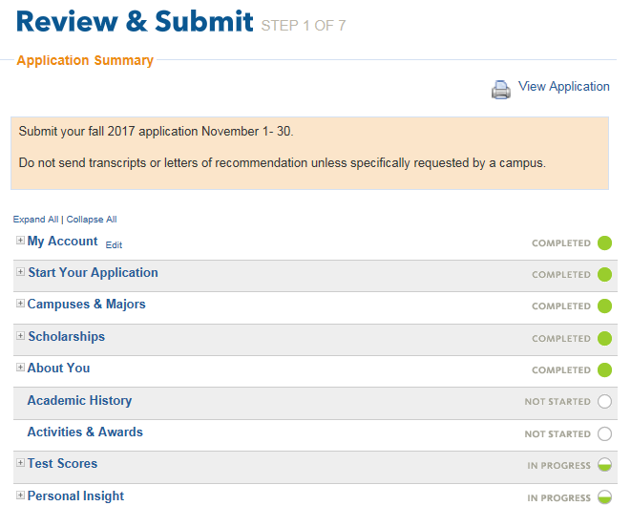

Submitting the Application
Disabled until all circles are solid.
38
Notes:
The application is not ready to submit unless all solid green circles are shown on the right.
Use the navigation buttons on the top banner to jump to the section(s) that need to be completed.
Use the View Application button to see and print the entire application.

Slide 39
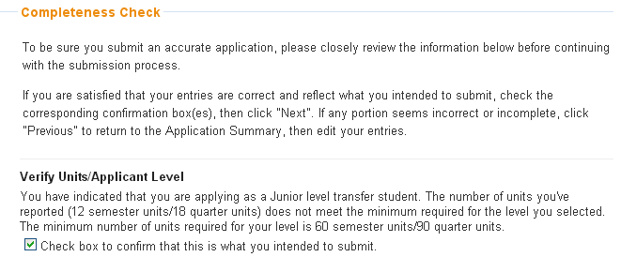
Completeness Check
39
Notes:
The application performs a completeness check, drawing attention to whether the minimum units required for the junior transfer requirement have been met.
Don’t forget to include AP/IB results, and for students who completed secondary education abroad, include external exam results in the Test Scores section of the application.

Slide 40
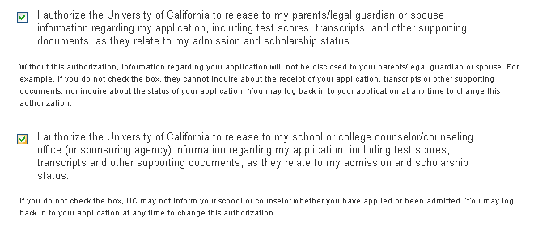
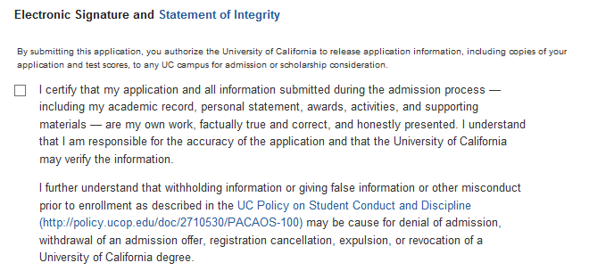
Release & Signature
40
Notes:
Finally, the application cannot be submitted without the electronic signature and acknowledgement of the Statement of Integrity.
Students are asked to provide authorization to release information. Without this authorization, UC is not allowed by law to discuss or share information with anyone. So be sure to check off the appropriate box(es).
Signature Releases
Review and check the release authorizations to share application information with scholarship agencies, parent/guardian, counselors and/or UC organizations and alumni groups.
Electronically sign and date the application to verify accuracy and acknowledge that the applicant is the author of their personal insight question responses.
Information in the application is subject to verification. If an applicant is selected for verification, non-compliance will result in cancellation of the application and the application fee will not be refunded.
UC feels very strongly about student integrity on the application. The Statement of Integrity is to affirm that all information in the application is accurate and the personal insight question responses were written by the applicant. If information is withheld, such as poor grades, enrollment at another collegiate institution or falsification is detected, the application is subject to cancellation.

Slide 41
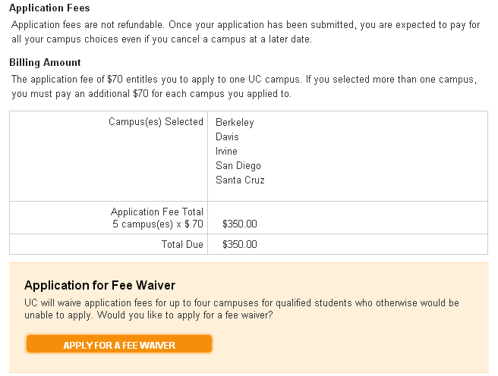
Fees, Payment & Waivers
41
Notes:
For U.S. citizens or permanent resident students, the application fee is $70 per campus.
For International and non-immigrant applicants the application fee of $80 for each campus selected. If an international or non-immigrant student currently attends school in the U.S., they may be eligible to pay the lower application fee of $70 per campus. The application tool will advise of the fee requirement on this page.
Payment is required and non-refundable.
Payment may be submitted by credit card in the application tool; or by mailing a check or fee waiver if a student didn’t qualify for the UC application fee waiver but meets criteria established by the provider.
Fee Waiver:
For U.S. citizens or permanent residents or students who have attended a CA high school for at least 3 years, and if students meet the low-income criteria used to qualify for free and reduced lunch, they will qualify for a UC application fee waiver for up to 4 campus choices but will be responsible for payment for any additional campus(es) to which they choose to apply. The fee waiver application approval section of the application can only be attempted once, so be sure the income information is correct before applying for the waiver.
If a student is denied the UC online fee waiver, a written request with corrected income and family size information can be submitted to the UC Application Center. UC also accepts the College Board and the California community college EOPS fee waiver.
Only one waiver can be used.

Slide 42
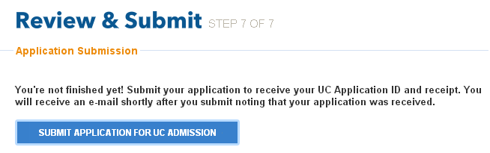
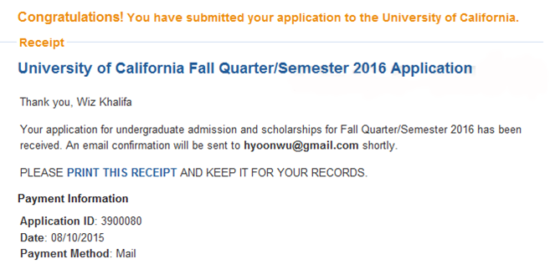
Submit
Click here
and expect this
Check your email for a submission confirmation
42
Notes:
When the applicant is at the “Submit” stage, they must carefully review all information and the personal insight question responses entered into the application.
While it may seem like a very simple step, don’t forget to click the submit button. Failure to do so, especially on the last day of application filing period, will lead to disastrous results.
Once “submit” is selected, that’s it, the application is gone and applicants will not be able to say “Oh no, I forgot to include X” or “I pasted in the wrong personal insight questions responses” or “I made a mistake on one of my courses or grades”.

Slide 43

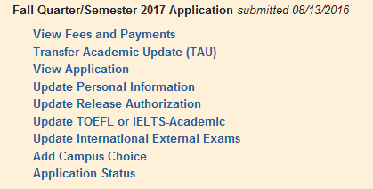
After Submission
43
Notes:
What can be done after submission?
If the name, email or password needs updating, go to the Account Information.
From “View Application,” a copy of the application can be printed.
Address changes are made in the Personal Information section.
If it’s before November 30th campuses are still open, additional campuses can be added.
If a student changes schools, adds or drops a course, or fails to earn a C or better in a course during the current academic year after submission of the application, they must notify UC, preferably using the Transfer Academic Update form, or by writing to the UC Application Center by email or postal mail. Correspondence must include the full name, UC Application ID number and signature (if you mail a letter) of the applicant. A copy will be made available to all the campuses to which the student applied.
Email: ucinfo@applyUCsupport.net
Mail to:
UC Application Center
P.O. Box 1432
Bakersfield, CA 93302
Minor changes to your activities, awards, volunteer work, employment or personal insight question responses are unlikely to have an impact on the admission decision. However, if a student has significant updates in any of these areas, they may notify us— by mail — at the UC Application Center.

Slide 44
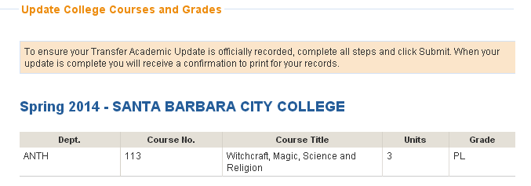
Transfer Academic Update
Update courses that were “in progress” with grades earned, and confirm or update planned courses for the current and future terms prior to enrollment at UC. Deadline is January 31.
44
Notes:
Even if an applicant is not currently enrolled, and all information was submitted on the original application, all transfer applicants are required to submit the Transfer Academic Update (TAU).
If a student is not currently enrolled, they would enter that information in the Comment Box.
If a student is currently enrolled, submit grades for fall 2016 courses and confirm or update the winter and/or spring courses.
The deadline to submit the TAU is January 31.

Slide 45
Resources
UC Admissions Home Page
admission.universityofcalifornia.edu/
How to Apply
admission.universityofcalifornia.edu/how-to-apply/index.html
Online Application
admissions.universityofcalifornia.edu/applicant/login.html
Help Desk
ucinfo@applyucsupport.net
1-800-207-1710 (U.S. only)
1-310-513-2715 (outside U.S.)
UC Application Center
P. O. Box 1432
Bakersfield, CA 93302
45
Notes:
Download the “Apply Online To UC” brochure (“quick-start guide”)
Transfer [PDF] admission.universityofcalifornia.edu/counselors/files/apply-online-transfer.pdf

Slide 46

Submitting the Application
Notes:
After a student has successfully submitted their UC admission application and printed a copy for their records – they can jump for joy – it’s done!

